Slide 1
Introduction to ML

Slide 2
What is Machine Learning
Where we tried to train machine to make prediction
Eg. Medical Diagnosis: Machine learning can analyze patient data to predict the likelihood of a disease.
Image Recognition: Algorithms can be trained to identify objects in images, like cats or dogs.
Tourist example:
Initially you took 10 or more years to understand the trend, where machine will take less time to understand this
So will try to teach machine, which given the same data can learn everything in less than 10 years
When certainty comes in mind, through machine we tried to measure and quantify the certainty
We are reducing uncertainty by quantifying certainty

Slide 3
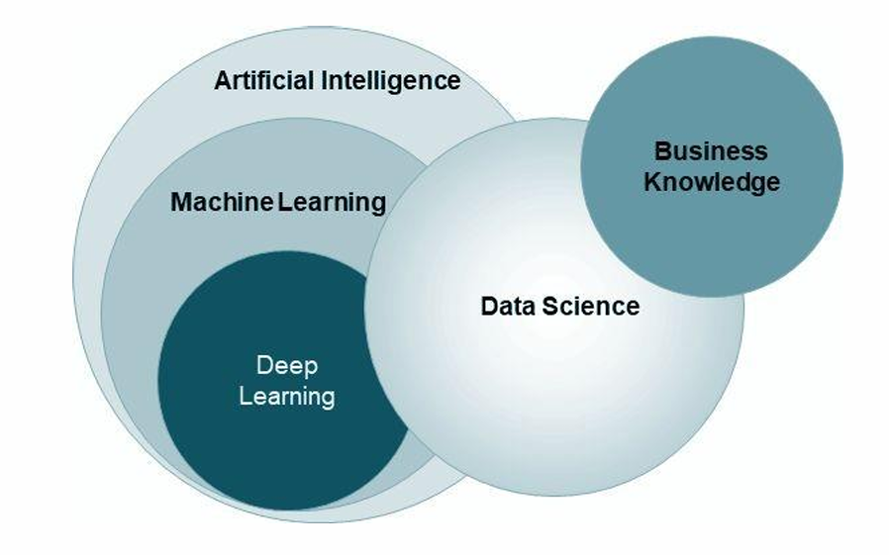
Field of Data Science

Slide 4
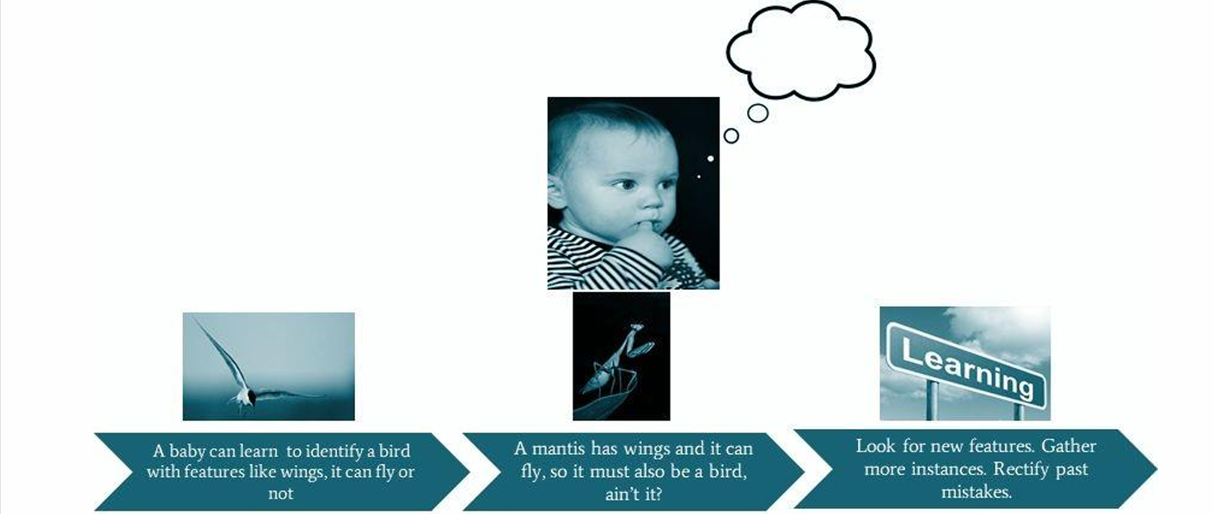
How do humans learn?

Slide 5
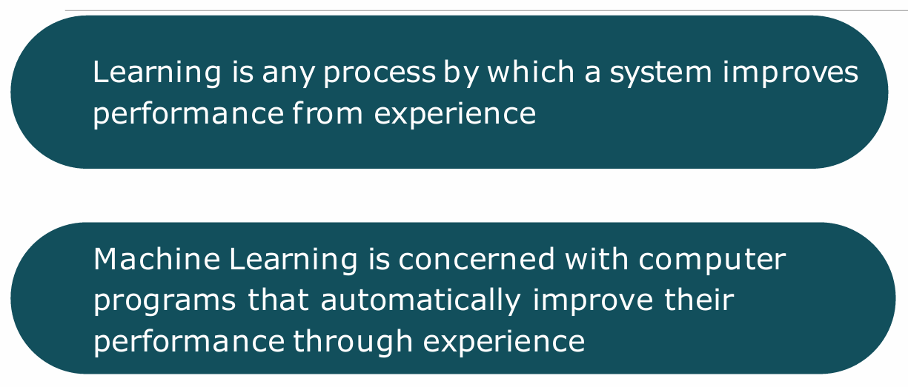
Machine Learning

Slide 6
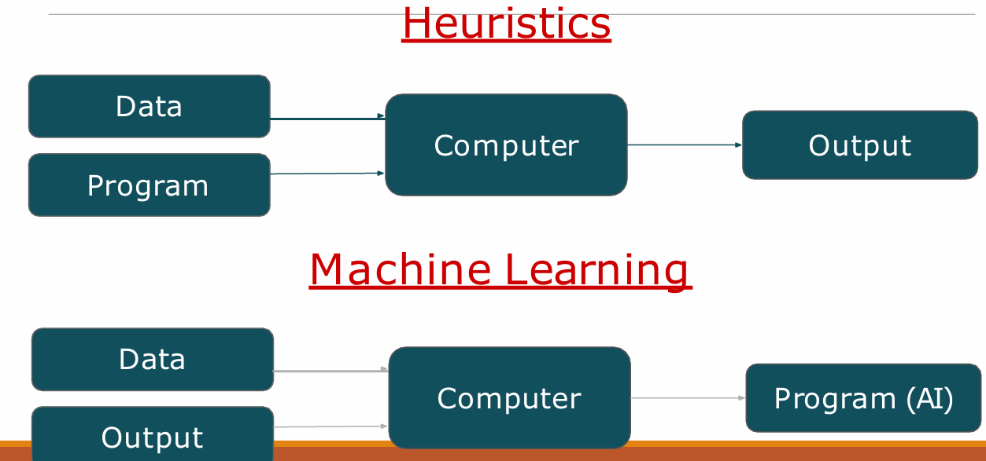

Slide 7
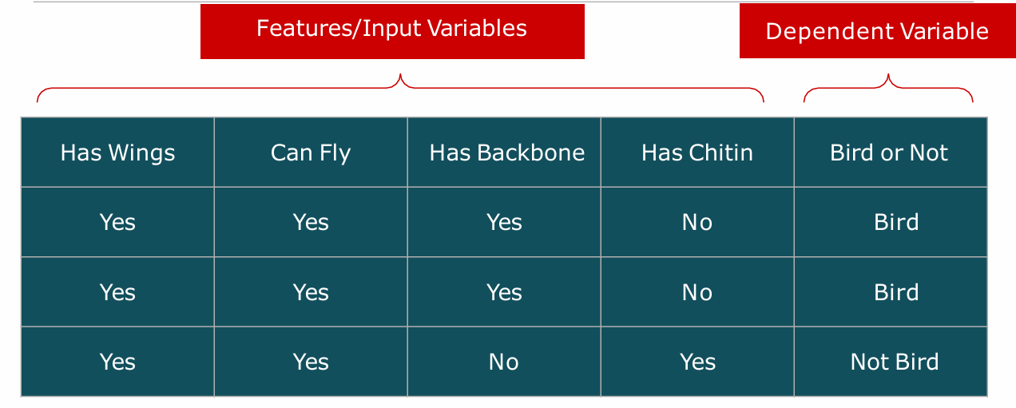

Slide 8
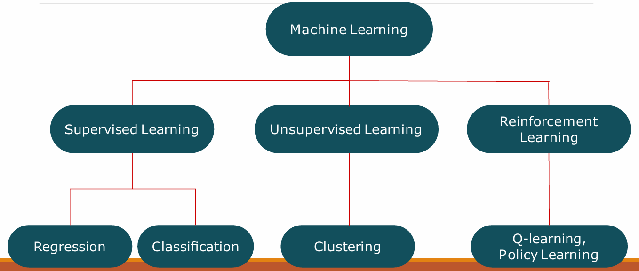
Types of ML

Slide 9
Supervised learning:- It is a machine learning approach where algorithms learn from labeled datasets to predict outcomes or recognize patterns, essentially "learning" from examples where the correct output is known.
Common applications include spam filtering, image classification, fraud detection, and predicting stock prices.
Unsupervised learning:- It is a machine learning involves training models on unlabeled data to discover hidden patterns, structures, and relationships without explicit guidance or predefined outcomes.
Eg:- Customer Segmentation:- Grouping customers based on their purchasing behavior and Fraud Detection Identifying unusual transactions or patterns that may indicate fraudulent activity.
Reinforcement Learning (RL) is a branch of machine learning that focuses on how agents can learn to make decisions through trial and error to maximize cumulative rewards. RL allows machines to learn by interacting with an environment and receiving feedback based on their actions. This feedback comes in the form of rewards or penalties.

Slide 10
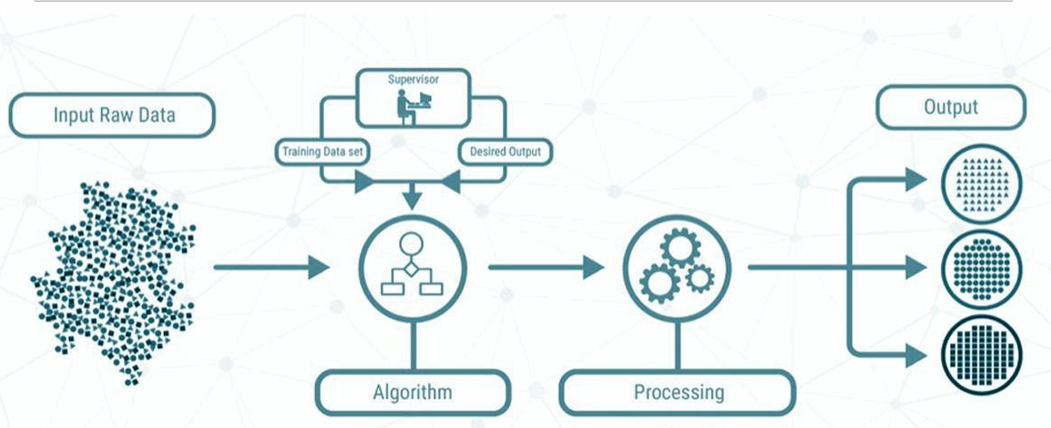
Supervised Learning

Slide 11
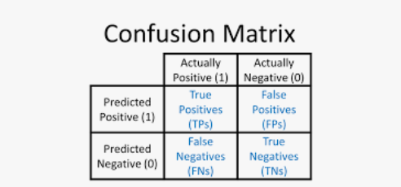
In supervised learning, we are using classification where in unsupervise we are using clustering
There is no learning in clustering because there is no past learning.
Confusion matrix will use to evaluate your classification model
A confusion matrix is a table that is used to define the performance of a classification algorithm. A confusion matrix visualizes and summarizes the performance of a classification algorithm.

Slide 12
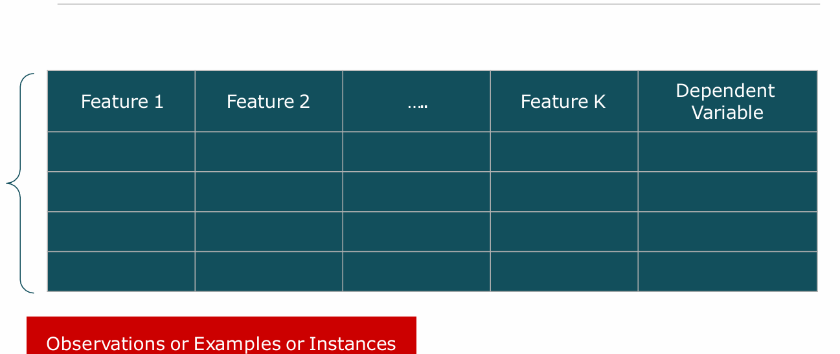
Dataset in Supervised Learning

Slide 13
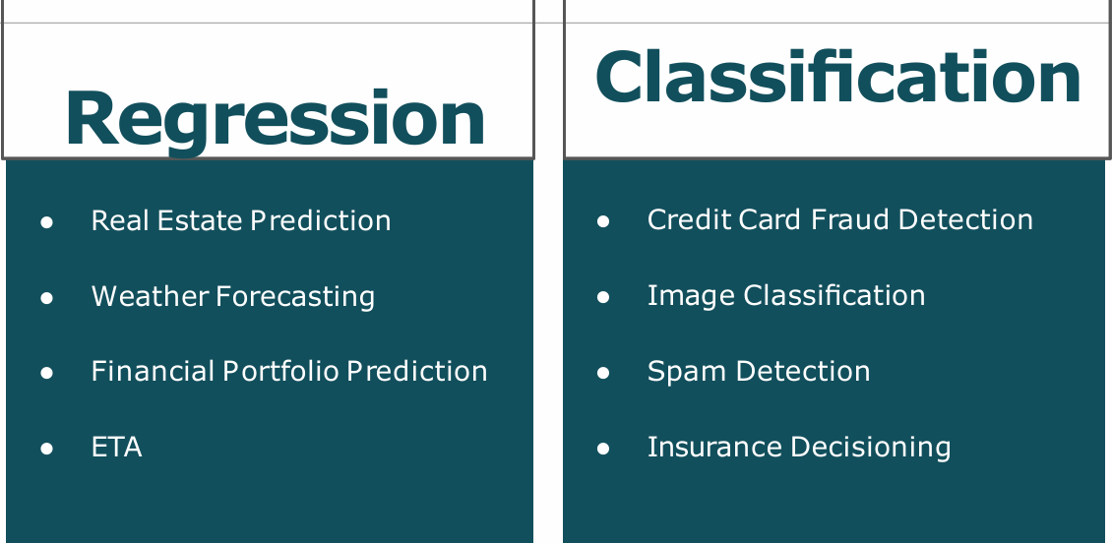
Classification and regression are same but they both have different application
Whenever you are predicting continuous you are using regression and at the time of discrete, you are using classification

Slide 14
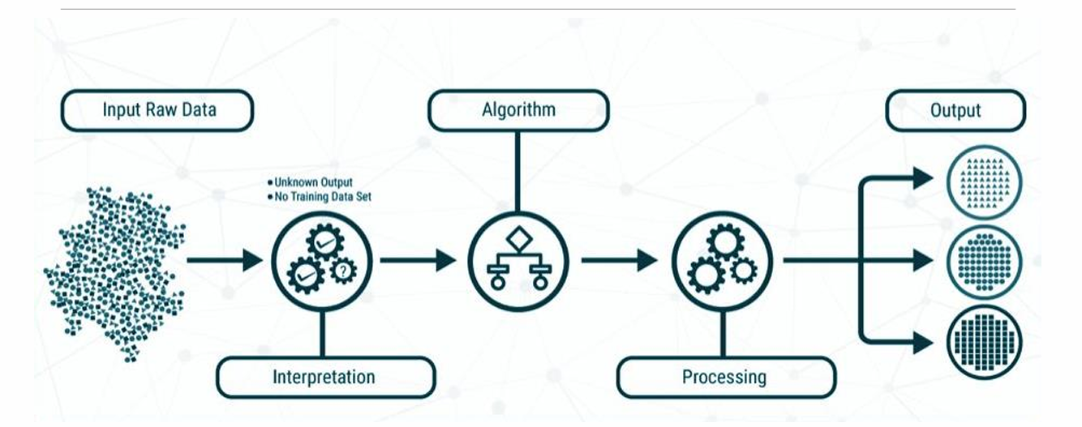
Unsupervised Learning

Slide 15
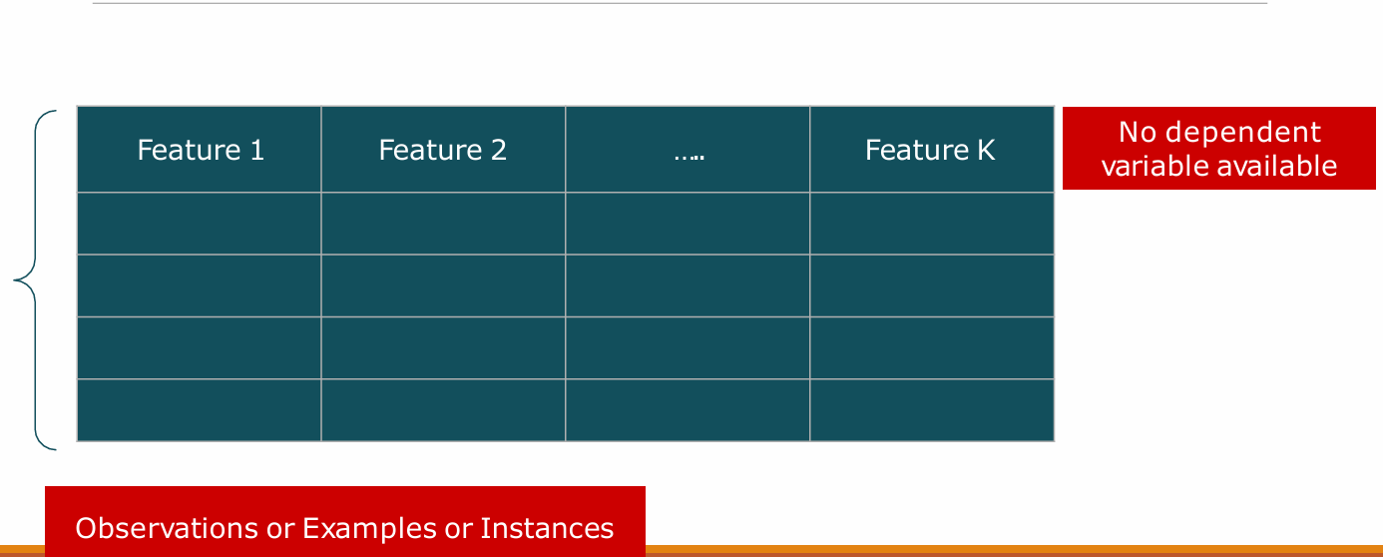
Dataset in Unsupervised Learning

Slide 16
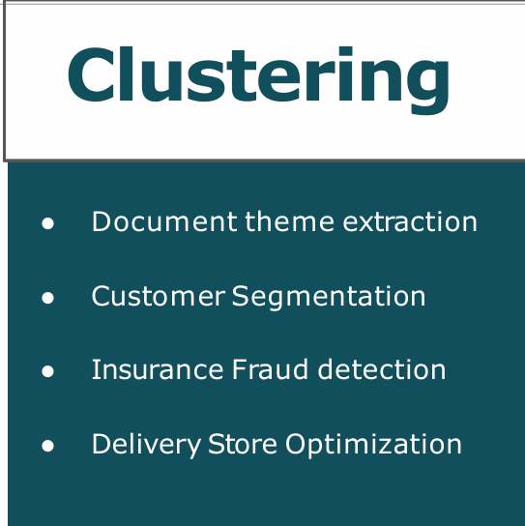
Application of Unsupervised Learning

Slide 17
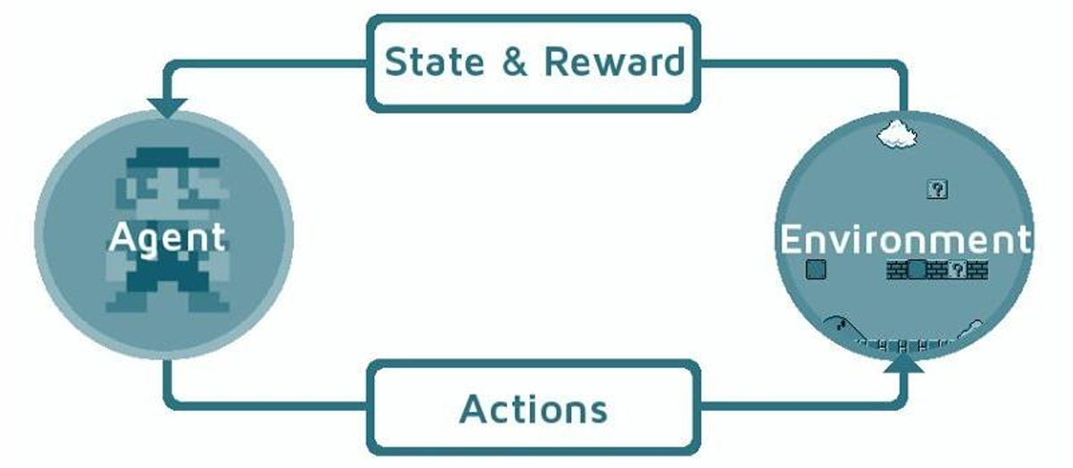
Reinforcement Learning

Slide 18
Reinforcement learning (RL) is a machine learning technique where an agent learns to make decisions in an environment to maximize a reward signal by interacting with it through trial and error.
Reinforcement learning take action quickly whether model is good or not.
A classic example is a self-driving car learning to navigate traffic, where the car is the agent, the environment is the road, and rewards/penalties are based on successful/unsuccessful maneuvers.
In ML, your goal should be your ML model more generalize rather then memorized
Where you have less training error and high test error so this will be memorizing because you are good on training data but if new data test will come then you have less error.
If you train error in good then your learning is not happened you have neither memorize or generalize your ML. You come and retrain your data
So in any of the large error you come back and revaluate your model. If both the things are fine then you can deploy your ML model
If your model will not run good (because of new data or some change) after deployment then you will come back and revaluate your model

Slide 19
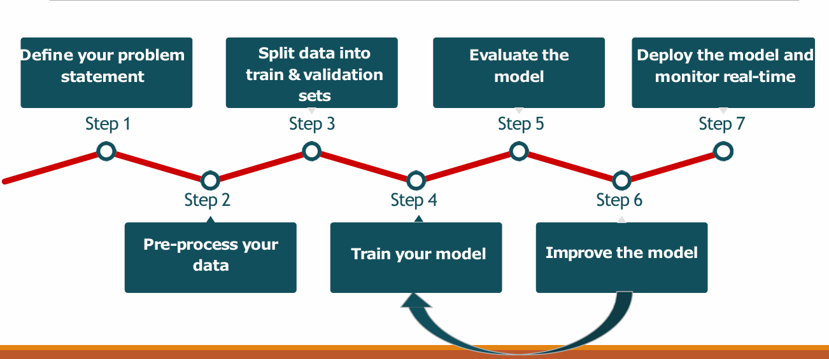
Steps in Supervised ML Modeling

